Slide 1
Java Networking
Partly adapted with permission from Eran Toch, Technion

Slide 2
History of Java
Java is a General Purpose, Object Oriented Programming Language
developed by Sun Microsystems of USA I 1991. Originally called Oak by
Games Gosling, one of the invention of the language, java was designed
for the development of software for consumer electronic devices like
TVs, VCRs, toasters and such other electronic Machines. This goal had a
strong impact on the development team to make the language simple,
portable and highly reliable. The java team which included Patrick
Naughton discovered that the existing languages like C and C++ had
limitations in terms of both reliability and portability. However, they
modeled their new language Java on C and C++ but removed a number
of features of of C and C++ that were considered as source of problems
and thus made java really simple, reliable, portable and powerful
language.

Slide 3
JDK v/s JRE v/s JVM
JDK
Java Development Kit is the core component of Java Environment and provides all the tools, executables and binaries required to compile, debug and execute a Java Program. JDK is a platform specific software and thats why we have separate installers for Windows, Mac and Unix systems. We can say that JDK is superset of JRE since it contains JRE with Java compiler, debugger and core classes. Current version of JDK is 1.9 also known as Java 9
JVM
JVM is the heart of java programming language. When we run a program, JVM is responsible to converting Byte code to the machine specific code. JVM is also platform dependent and provides core java functions like memory management, garbage collection, security etc. JVM is customizable and we can use java options to customize it, for example allocating minimum and maximum memory to JVM. JVM is called virtual because it provides a interface that does not depend on the underlying operating system and machine hardware. This independence from hardware and operating system is what makes java program write-once run-anywhere.
. JRE
JRE is the implementation of JVM, it provides platform to execute java programs. JRE consists of JVM and java binaries and other classes to execute any program successfully. JRE doesn’t contain any development tools like java compiler, debugger etc. If you want to execute any java program, you should have JRE installed but we don’t need JDK for running any java program.

Slide 4
To Summarize
JRE = JVM + Required Library to run Application.
JDK = JRE + Required Library to develop Java Application.
So…..
JDK is for development purpose whereas JRE is for running the java programs.
JDK and JRE both contains JVM so that we can run our java program.
JVM is the heart of java programming language and provides platform independence.
Notes:
Ordinarily, you compile source files with javac then run the program using java. However, java can be used to compile and run programs when the -cs option is used. As each class file is loaded its modification date is compared to the modification date of the class source file. If the source has been modified more recently, it is recompiled and the new class file is loaded. java repeats this procedure until all the classes are correctly compiled and loaded.
The interpreter can determine whether a class is legitimate through the mechanism of verification. Verification ensures prior to their execution that class files do not violate any language constraints

Slide 5
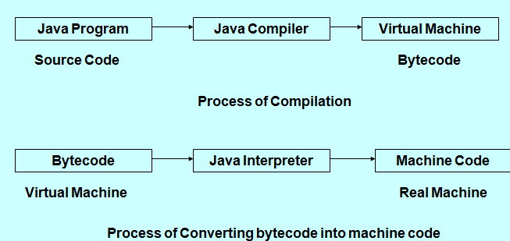
Notes:
In Java you have to write and compile a program only once. The Java on any platform will interpret the compiled bytecode into instructions understandable by the particular processor. However java virtual machine handles only one bytecode instruction at a time that makes execution slow. But Using the Java just-in-time compiler at the particular system platform compiles the bytecode into the particular system code. After the code has been (re-)compiled by the JIT compiler, it will usually run more quickly on the computer.
The just-in-time compiler comes with JVM and is used optionally. It compiles the bytecode into platform-specific executable code that is immediately executed. JIT compiler option should be used especially if the method executable is repeatedly reused in the code.
Main difference between JVM and JIT is there purpose, main goal of JVM is to provide platform independence while objective of JIT is to improve performance of JVM, by compiling more code into machine language. Just keep in mind that this compilation also takes time, so translating all code into native code is not worth doing. That's why JIT mostly compile frequently used code into native code. 3) Another difference between JIT and JVM is that, JIT is part of JVM. One example of JIT is Oracle's Hotspot JIT which comes with Hotspot JVM.
2) At last, JVM is older concept than JIT. JIT actually get invented to improve performance of JVM.
You can disable the JIT compiler using the -Djava.compiler=NONE option to the Java VM. down vote
(Not a direct answer to your question since it seems your were trying to turn off the JIT compiler programmatically, but based on your comment, this might be of interest.)
If you want to turn off the JIT compiler on a Sun/Oracle JVM, you should try the -Xint option:
-Xint
Operate in interpreted-only mode. Compilation to native code is disabled, and all bytecodes are executed by the interpreter. The performance benefits offered by the Java HotSpot Client VM's adaptive compiler will not be present in this mode. It's available in the options when you type java -X in Oracle JRE 8browser.The java compiler is written in
Java, and the interpreter is written in C. The Java Interpreter can execute Java
Code directly on any machine on which a Java interpreter has been installed.

Slide 6
First Java Application
Create the File
The first step to create the HelloWorld application is to copy the text from listing 7.1 into a file called HelloWorld.java using your favorite text editor (by choosing Windows, NotePad, or SimpleText on the Macintosh). It is very important to call the file HelloWorld.java, because the compiler expects the file name to match the class identifier
Listing 7.1 The HelloWorld application.
public class HelloWorld {
public static void main(String args[]){System.out.println("Hello World!!");
}}

Slide 7
Compile, Run java program
Compile the Code
To compile the program, you need to first install the JDK. Then, use the program
javac included with the JDK to convert the text in listing 7.1 to code which the
computer can run. To run javac, on a Macintosh drag the source file over the javac
icon. On any other computer, type the line:
javac HelloWorld.java
at a command prompt. The javac program creates a file called HelloWorld.class
from the HelloWorld.java file. Inside this file (HelloWorld.class) is text known as
bytecodes which can be run by the Java interpreter.
Run the Program
Now that you have compiled the program, you can run it by typing at the command prompt:
java HelloWorld
After you do this, the computer should print to the screen
Hello World!!
That may not seem very interesting, but then it's a simple program. If you don't see the Hello World!! on the screen, go back and make sure you have typed in the file exactly as shown in listing 7.1, and make sure that you called the file HelloWorld.java.

Slide 8
JAVA CONTROLS
Variables and Constants
Arithmetic Operator and Expressions
Type Conversion in Java
Comments in Java(3 Types)
Java’s Control Statements
If
If-else
Do-while
While
for
Increment and Decrement Operators
Escape Sequences Characters
Relational and Logical Operators
Ternary Operators
Switch case
Break
Bitwise Operators
Arrays-Single and Multidimensional

Slide 9
Data Types
Data Types in Java
Primitive (Intrinsic)
Non-Primitive ( Derived)
Numeric
Non-Numeric
Classes
Arrays
Floating Point
Interface
Integer
Character
Boolean
Integer Types
Java consists of four integer types: byte, short, int, and long, which are defined as 8-, 16-, 32-, and 64-bit signed values as summarized in Table below :

Slide 10
The Java integer primitive types.
Type | Bit Size | Minimum Value | Maximum Value
byte | 8 | -128 | +127
short | 16 | -32,768 | 32,767
int | 32 | -2,147,483,648 | 2,147,483,647
long | 64 | -9,223,372,036,854,775,808 | 9,223,372,036,854,775,807
Integer literals can be specified in decimal, hexadecimal, or octal notation. To specify a decimal
value, simply use the number as normal. To indicate that a literal value is a long, you can append
either "L" or "l" to the end of the number. Hexadecimal values are given in base 16 and include
the digits 0-9 and the letters A-F. To specify a hexadecimal value, use 0x followed by the digits
and letters that comprise the value. Similarly, an octal value is identified by a leading 0 symbol.
For examples of specifying integer literals, see Table 3.7.

Slide 11
Table 3.7. Examples of integer literals.
Integer | Long | Octal | Hexadecimal
0 | 0L | 0 | 0x0
1 | 1L | 01 | 0x1
10 | 10L | 012 | 0xA
15 | 15L | 017 | 0XF
16 | 16L | 020 | 0x10
100 | 100L | 0144 | 0x64
Floating-Point Types
Support for floating-point numbers in Java is provided through two primitive types-float and double, which are 32- and 64-bit values, respectively.
Similar to integer literals are Java's floating-point literals. Floating-point literals can be specified in
either the familiar decimal notation (for example, 3.1415) or exponential notation (for example, 6.02e23).
To indicate that a literal is to be treated as a single precision float, append either "f" or "F". To indicate that

Slide 12
it is to be treated as a double precision value, append either "d" or "D".
Java includes predefined constants, POSITIVE_INFINITY, NEGATIVE_INFINITY, and NaN, to represent the infinity and not-a-number values.
The following list shows some valid floating-point literals:
43.3F,3.1415d,-12.123f,6.02e+23f,6.02e23d,6.02e-23f,6.02e23d
Boolean :- Java supports two Boolean literals-true and false.
Character Literals :-A character literal is a single character or an escape sequence enclosed in single quotes, for example, 'b'. Escape sequences are used to indicate special characters or
actions, such as line feed, form feed, or carriage return. The available escape sequences ar shown in Table 3.8.
String Literals
Although there is no string primitive type in Java, you can include string literals in your programs. Most applications and applets will make use of some form of string literal, probably at least for error messages. A string literal consists of zero or more characters (including the escape sequences shown in Table 3.8) enclosed in double quotes. As examples of string literals, consider the following: "A String“,"Column 1\tColumn 2”

Slide 13
Table 3.8. Escape sequences.
Sequence | Purpose
\b | Backspace
\t | Horizontal tab
\n | Line feed
\f | Form feed
\r | Carriage return
\" | Double quote
\' | Single quote
\\ | Backslash
\uxxxx | Unicode character

Slide 14
Arithmetic Operators and Expressions
An expression is a operators and operands. It follows the rules of algebra and should be familiar. Java allows several types of expressions. The arithmetic operators are given below :
+→ addition
-→subtraction
*→multiplication
/→ division
%→ modulus
+=→ addition assignment
-=→subtraction assignment
*=multiplication assignment
/=division assignment
%=→modulus assignment
++→increment,--→decrement

Slide 15
An expression may appear on the right side of an assignment statement. For example,
Int answer;
Answer=100*31;
Java expression may contain Variables, constants or both. For example assuming that answer and count are variables, this expression is perfectly valid.
Answer=count-100;

Slide 16
Increment/Decrement Operators
The increment and decrement operators are used with one variable (they are known as unary operators):
++ increment operator
-- decrement operator
For instance, the increment operator (++) adds one to the operand, as shown in the next line of code:
x++;
is the same as
x+=1;
The increment and decrement operators behave slightly differently based on the side of the operand they are placed on. If the operand is placed before the operator (for example, ++x), the increment occurs before the value is taken for the expression. So, in the following code fragment, the result of y is 6:
int x=5;int y=++x; // y=6 x=6
If the operator appears after the operand, the addition occurs after the value is taken. So y is 5 as shown in the next code fragment. Notice that in both examples, x is 6 at the end of the fragment.
int x=5;int y = x++; //y=5 x=6
Similarly, the decrement operator (--) subtracts one from the operand, and the timing of this is in relation to the evaluation of the expression that it occurs in.

Slide 17
The Relational Operators
The most intuitive comparative operators are those that fall into a category known as relational operators. Relational operators include those standard greater-than and less-than symbols you learned about back in third grade. Conveniently enough, they work the same way as they did back in third grade, too. For instance, you know that if you write (3>4), you wrote something wrong (false). On the other hand (3<4) is correct (true). In Java and most other languages, you are not limited to evaluating constants; you are free to use variables, so the statement (Democrats> Republicans) is also valid. The complete list of relational operators is shown here:
Operator Boolean Result
< Less than
<= Less than or equal to
> Greater than
>= Greater than or equal to
The following two assignment statements produce identical results:
result1 = a+b < c*d ;
result2 = (a+b) < (c*d) ;
Logical Expressions
The third set of evaluation operators fall into a category known as logical expressions. Logical expressions work a bit differently than the previous operators, and are probably not something you covered in your third grade math class.

Slide 18
Logical expressions operate either on a pair of booleans, or on the individual bits of an object. There are two types of logical operators which are divided roughly along these lines:
Boolean operators. Only operate on Boolean values.
Bitwise operators. Operate on each bit in a pair of integral operands.
The Conditional-And and Conditional-Or Operators
There are two primary Boolean operators:
Logical-AND: &&
Logical-OR: ||
Oddly, in most computer languages, including Java, there is no Conditional-XOR operator.
When A is | And when B is | (A && B) | (A || B)
false | false | false | false
false | true | false | true
true | false | false | true
true | true | true | true

Slide 19
The Conditional Operator
The conditional operator is the one ternary or triadic operator in Java, and operates as it does in C and C++. It takes the following form:
expression1 ? expression2 : expression3
In this syntax, expression1 must produce a Boolean value. If this value is true, then expression2 is evaluated, and its result is the value of the conditional. If expression1 is false, then expression3 is evaluated, and its result is the value of the conditional.
Consider the following examples. The first is using the conditional operator to determine the maximum of two values; the second is determining the minimum of two values; the third is determining the absolute value of a quantity:
BestReturn = Stocks > Bonds ? Stocks : Bonds ;
LowSales = JuneSales < JulySales ? JuneSales : JulySales ;
Distance = Site1-Site2 > 0 ? Site1-Site2 : Site2 - Site1 ;
In reviewing these examples, think about the precedence rules, and convince yourself that none of the three examples requires any brackets in order to be evaluated correctly.

Slide 20
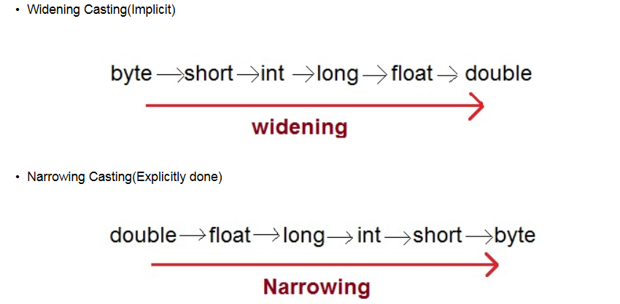
Type Conversion in Java

Slide 21
Comments in Java
Start | End | Purpose
/* | */ | The enclosed text is treated as a comment.
// | (none) | The rest of the line is treated as a comment.
/** | */ | The enclosed text is treated as a comment by the compiler but is used by JavaDoc to automatically generate documentation.

Slide 22
Java Control Statements
Control Statement
Selection Statement
Iteration Statement
Jump Statement
if
continue
return
If-else
switch
break
while
Do while
for

Slide 23
Flow control
Basically, it is exactly like c/c++.
do/while
switch
int i=5;
do {
// act1
i--;
} while(i!=0);
if/else
char c=IN.getChar();
switch(c) {
case ‘a’:
case ‘b’:
// act1
break;
default:
// act2
}
If(x==4) {
// act1
} else {
// act2
}
for
int j;
for(int i=0;i<=9;i++)
{
j+=i;
}

Slide 24
ARRAYS
One Dimensional Array : is a list of variables of the same type that are accessed through a common name. An Individual variable in the array is called an array element. Arrays from a convenient way to handle groups of related data.
To create an array, you need to perform two steps :
Declare Array
2. Allocate space for its elements.
General Form for declaring one dimensional array given below :
type varName[];
Here, type is a valid Java data type and varName is the name of the array. Like int a[];
This creates a variable named a that refers to an integer array. But it does not actually create storage for the array.
Second approach to allocate space for One Dimensional Array is

Slide 25
varName=new type[size];
Here varName is name of the array, type is a valid Java type, and size specifies the number of elements in the array. You can see that the new operator is used to allocate memory for the array.
These two steps combines like
type varName=new type[size];
For example consider this declaration and allocation :
Int ia=new int[10];
Represents the structure of a one-dimensional array,here ia is array variable name that can hold 10 integer values.
Multidimensional Array :
In addition to one dimensional we can create arrays of two or more dimensions. In Java, Multidimensional array are implemented as arrays of arrays. You need to perform two steps to work with multidimensional arrays : 1. Declare the array and 2. allocate space for its elements.

Slide 26
The General form is given below :
Type varname = new type[size1][size2];
float a[][]=new float[2][2];
Here a is two dimensional array having 2 rows and 2 columns. i.e. size is 4, we can store 4 elements in that array.

Slide 27
Different Programming Paradigms
Functional/procedural programming:
program is a list of instructions to the computer
Object-oriented programming
program is composed of a collection objects that communicate with each other
Notes:
flexibility, easing changes to programs
easier to learn
simpler to develop, maintain and analysize

Slide 28
JAVA Classes and Methods
The General Form of a class
Constructor and Method Overloading
The new Operator
Garbage Collection
Finalize method
Command Line Arguments
The System Class

Slide 29
The General Form of Class
A class array contains three types of items : variable,methods, and constructors. Variable represent its state. Method provide the logic that constitutes the behavior defined by a class. The variable and methods can be both static and instance variable. Constructors initialize the state of a new instance of a class.
The Simplified form of a class is :
class clsName {
//instance variable declarations
type1 varName1=value1;
type2 varName2=value2;
…..
//constructor
clsName(cparams1) {
// body of constructor
}
Notes:
You cannot write two constructors that have the same number and type of arguments for the same class, because the platform would not be able to tell them apart. Doing so causes a compile-time error. This default constructor will call the no-argument constructor of the superclass. In this situation, the compiler will complain if the superclass doesn't have a no-argument constructor so you must verify that it does. You can use a superclass constructor yourself Varargs: Treated like arrayThe method can be called either with an array or with a sequence of argumentspublic PrintStream printf(String format, Object... args) typical Java program creates many objects, which as you know, interact by invoking methods. Through these object interactions, a program can carry out various tasks, such as implementing a GUI, running an animation, or sending and receiving information over a network. Once an object has completed the work for which it was created, its resources are recycled for use by other objects. Declaring a Variable to Refer to an Object
Previously, you learned that to declare a variable, you write:
type name;
This notifies the compiler that you will use name to refer to data whose type is type. With a primitive variable, this declaration also reserves the proper amount of memory for the variable.
You can also declare a reference variable on its own line. For example:
Point originOne;
If you declare originOne like this, its value will be undetermined until an object is actually created and assigned to it. Simply declaring a reference variable does not create an object. For that, you need to use the new operator, as described in the next section. You must assign an object to originOne before you use it in your code. Otherwise, you will get a compiler error.

Slide 30
clsName(cparamsN) {
//body of constructor
}
…
//methods
rtype1 mthName(mparams1) {
//body of method
}
…..
}
}
The keyword class indicates that a class named clsName is being declared. This name must follow the Java naming convention for identifiers. The instance Variables named varName1 through varNameN included using the normal variable declaration syntax. Each variable must be assigned a type shown as

Slide 31
type1 through typeN and may be initialized to value shown as value1 through valueN.
Constructors always have the same name as the class. They do not have return values.
Method named mthName1 through mthNameN can be included. The return type of the methods are rType1 through rtypeN, and their Optional Parameter lists are mparams1 through mparamsN.
Constructors
Often an object will require some form of initialization when it is created. To accommodate this, Java allows you to define constructor for your classes. A Constructor is a special method that creates and initializes an object of a particular class. It has the same name as its class and may accept arguments. Constructor does not have a return type. Instead, a constructor returns a reference to the object that it creates.
Constructor Overloading
A class may have several constructors. This feature is called constructor overloading. When constructors are overloaded each is still called by the name of its class. However it must have a different parameter list. i.e. Signature of each constructor must differ.
Notes:
Protected variables can be referred in subclass in diff package by only child class object. Not by the parent class object. a program can have multiple references to the same object; all references to an object must be dropped before the object is eligible for garbage collection.

Slide 32
Method Overloading
Like Constructor, method can also be overloaded. This occurs when two or more methods have the same name but different signature. Recall that the signature of a method is a combination of its name and the sequence of the parameter types.
Method Overloading allows you to use the same name for a group of methods that basically have the same purpose. The println() is an good example of this concept. It has so many Overloaded forms.Each of these accepts one argument of a different type. Another advantage of method overloading is that it provides an easy way to handle default parameter values.
The New Operator
Objects are created using the new operator. The new Operator creates an instance of a class. It is invoked as follows :
clsName obhRef=new clsName(args);
Here, clsName is the name of the class to instantiated. (Instantiated means to create an instance.) A reference to the new object is assigned to a variable named objRef. Notice the expression immediately to the right of the keyword new. This is known as constructor. A constructor creates an instance of the class. It has the same name as the class and may optionally have an argument list args.

Slide 33
Access Levels
Access Levels
Modifier | Class | Package | Subclass | World
public | Y | Y | Y | Y
protected | Y | Y | Y | N
no modifier | Y | Y | N | N
private | Y | N | N | N
Notes:
The runtime system guarantees that static initialization blocks are called in the order that they appear in the source code. •Returning values from methods.
•The this keyword.
•Class vs. instance members.
•Access control.
A method returns to the code that invoked it when it
•completes all the statements in the method,
•reaches a return statement, or
•throws an exception (covered later),
Any method declared void doesn't return a value. It does not need to contain a return statement, but it may do so. In such a case, a return statement can be used to branch out of a control flow block and exit the method and is simply used like this:
return;
covariant return type, means that the return type is allowed to vary in the same direction as the subclass.
Note: You also can use interface names as return types. In this case, the object returned must implement the specified interface. this is a reference to the current object — the object whose method or constructor is being called. You can refer to any member of the current object from within an instance method or a constructor by using this.this keyword to call another constructor in the same class. Doing so is called an explicit constructor invocation.

Slide 34
Garbage Collection
Garbage collection is the mechanism that reclaims the memory resources of an object when it is no longer referenced by a variable. It prevents programming errors that could otherwise occur by incorrectly deleting or failing to delete objects. An object becomes eligible for garbage collection when it is no longer referenced by any Variable. However, the JVM determines exactly when this task is performed.
finalize method :
Constructor method used to initialize an object when it is declared. This process is known as initialization. Similarly, Java supports a concept called finalization, which is just opposite to Initialization. We know that java run-time is an automatic garbage collecting system. It automatically frees up the memory resources used by the objects. But objects may hold other non-object resources such as file descriptors or window system fonts. The garbage collector cannot free these resources. In order to free these resources we must use a finalizer method. This is similar to destructor of C++.
The finalizer method is simply finalize() and can be added to any class. Java calls that method whenever it is about to reclaim the space for that object. The finalize method should explicitly define the tasks to be performed.

Slide 35
Command Line Arguments
All java application contain a static method named main().This method takes one argument that is an array of String objects. These objects represent any arguments that may have been entered by the user on the command line. The number of command line arguments is obtained via the expression args.length. This is an int type. The individual arguments are accessed as arg[0],args[1],args[2], and so forth.
The System Class
The system class defines several attributes relate to the run-time environment. It has a static variable named out that contains a reference to a PrintStream object. The print() and println() methods of that object display their string arguments on the standard output. The static variable err also holds a reference to PrintStream object. This is the standard error stream. The static variable in contains a reference to an InputStream object. PrintStream and InputStream are classes that provide support for I/O.
Another static method of the system class is exit(). It determines the current application.

Slide 36
Instance Variables and Methods
Each object has its own copy of all the instance variables defined by its class. Thus an Instance variable relates to an instance (object) of its class. Instance variable may be declared by using the following form :
type varName1;
Here, the name of the variable is varName1 and the required type is type.
Instance variables are initialized to default values during the creation of an object.
A Instance Method acts upon an object and can be declared, as follows:
rtype mthname(mparams) {
//body of method
}
Here mthName is the name of the method and type is its return type.
Static Variables and Methods
A static variable is shared by all objects of its class and thus relates to the class itself. A static variable may be declared by using the static keyword as a modifier as follows:
static type varName1;
Here the name of the variable ios varName1 and its type is type.
Static variables are initialized to default values when the class loaded into the memory.

Slide 37
A static method may be declared by using the static keyword as a modifier. A static method acts relative to a class. It deos not act on specific objects of its class. To declare a static method as :
static rtype mthName(mparams) {
//body of method
}
}
Here mthName is the name of the method and rtype is its return type an optional list of parameter types shown as mparams may be specified.
String Class
Strings are class instantiated object and implemented using String Class.
String class expressed as :
String stringName=new String(“string”);
A string class defines a number of methods that allows you to accomplish a variety of string manipulation tasks like compareTo() method used to sort an array of strings in alphabetical order.

Slide 38
STRINGS
Strings represent a sequence of characters. The easiest way to represent a sequence of characters in Java is by using a character array. Example : char charArray[]=new char[4];
We can declare string using Characters but there is limitation that we can not use functions related with strings using array like copy of an array is difficult. For that Java provides String class using objects.
for that two classes are used String and StringBuffer. A Java String is an instantiated object of the String class.
String stringName;
stringName=new String ("string");
String Array :
String itemArray[]=new String[3];//will create itemArray of size 3 to hold three string constants.

Slide 39
String Methods :
The String Class defines a number of methods that allow us to accomplish a veriety of string manipulation tasks.
s2=s1.toLowerCase; //converts the string s1 to all lowercase
s2=s1.toUpperCase; //converts the string s1 to all Uppercase
s2=s1.replace('x','y'); //Replace all occurance of x with y
s2=s1.trim() //Removes the white spaces at the beginning and end of the String s1.
s1.equals(s2) //Returns true if s1 is equal to s2
s1.equalsIgnoreCase(s2) //Returns true if s1=s2, ignoring the case of characters.
s1.length() //Gives the Length of s1
s1.charAt(n) //Gives nth character of s1
s1.compareTo(s2) //Returns negative if s1<s2,positive if s1>s2, and zero if s1 is equal to s2
s1.concat(s2) //concatenates s1 and s2
s1.substring(n) //Gives substring starting from nth character

Slide 40
Simple type Wrapper Class
boolean Boolean
char Character
double Double
float Float
int Integer
long Long
The Wrapper classes have number of unique methods for handling primitive data types and objects.
Converting Primitive Numbers to Object Numbers Using Constructor Methods :
Integer IntVal=new Integer(i);//Primitive integer to Integer Objects here i as primitive data values.
Converting Object Numbers to primitive Numbers using typeValue() method
int i=IntVal.intValue();//Object to primitive integer
Converting Numbers to Strings Using toString() method
str=Integer.toString(i);//Primitive integer to string

Slide 41
Converting String Objects to Numeric Objects using the Static Method valueOf()
IntVal=Integer.valueOf(str);//converts string to Integer objects
Converting Numeric Strings to Primitive Numbers using Parsing Method
int i=Integer.parseInt(str);//converts string to primitive integer.

Slide 42
Abstract
abstract member function, means that the function does not have an implementation.
abstract class, is class that can not be instantiated.
AbstractTest.java:6: class AbstractTest is an abstract class.
It can't be instantiated.
new AbstractTest();
^
1 error
NOTE:
An abstract class is not required to have an abstract method in it.
But any class that has an abstract method in it or that does
not provide an implementation for any abstract methods declared
in its superclasses must be declared as an abstract class.
Example

Slide 43
Abstract - Example
package java.lang;
public abstract class Shape {
public abstract void draw();
public void move(int x, int y) {
setColor(BackGroundColor);
draw();
setCenter(x,y);
setColor(ForeGroundColor);
draw();
}
}
package java.lang;
public class Circle extends Shape {
public void draw() {
// draw the circle ...
}
}

Slide 44
Interface
Interfaces are useful for the following:
Capturing similarities among unrelated classes without artificially forcing a class relationship.
Declaring methods that one or more classes are expected to implement.
Revealing an object's programming interface without revealing its class.

Slide 45
Interface
abstract “class”
Helps defining a “usage contract” between classes
All methods are public
Java’s compensation for removing the multiple inheritance. You can “inherit” as many interfaces as you want.
Example
* - The correct term is “to implement”
an interface

Slide 46
Interface
interface IChef {
void cook(Food food);
}
interface BabyKicker {
void kickTheBaby(Baby);
}
interface SouthParkCharacter {
void curse();
}
class Chef implements IChef, SouthParkCharacter {
// overridden methods MUST be public
// can you tell why ?
public void curse() { … }
public void cook(Food f) { … }
}
* access rights (Java forbids reducing of access rights)

Slide 47
When to use an interface ?
Perfect tool for encapsulating the classes inner structure. Only the interface will be exposed

Slide 48
Collections
Collection/container
object that groups multiple elements
used to store, retrieve, manipulate, communicate aggregate data
Iterator - object used for traversing a collection and selectively remove elements
Generics – implementation is parametric in the type of elements

Slide 49
Java Collection Framework
Goal: Implement reusable data-structures and functionality
Collection interfaces - manipulate collections independently of representation details
Collection implementations - reusable data structures
List<String> list = new ArrayList<String>(c);
Algorithms - reusable functionality
computations on objects that implement collection interfaces
e.g., searching, sorting
polymorphic: the same method can be used on many different implementations of the appropriate collection interface

Slide 50
Collection Interfaces
Collection
Map
Set
List
Queue
Sorted Map
SortedSet

Slide 51
Collection Interface
Basic Operations
int size();
boolean isEmpty();
boolean contains(Object element);
boolean add(E element);
boolean remove(Object element);
Iterator iterator();
Bulk Operations
boolean containsAll(Collection<?> c);
boolean addAll(Collection<? extends E> c);
boolean removeAll(Collection<?> c);
boolean retainAll(Collection<?> c);
void clear();
Array Operations
Object[] toArray(); <T> T[] toArray(T[] a); }

Slide 52
General Purpose Implementations
Collection
Map
Set
List
Queue
Sorted Map
SortedSet
HashSet
TreeSet
ArrayList
LinkedList
TreeMap
HashMap
List<String> list1 = new ArrayList<String>(c);
List<String> list2 = new LinkedList<String>(c);

Slide 53
final
final member data Constant member
final member function The method can’t be overridden.
final class ‘Base’ is final, thus it can’t be extended
final class Base {
final int i=5;
final void foo() {
i=10;
//what will the compiler say about this?
}
}
class Derived extends Base { // Error
// another foo ...
void foo() {
}
}
(String class is final)

Slide 54
final
Derived.java:6: Can't subclass final classes: class Base
class class Derived extends Base {
^
1 error
final class Base {
final int i=5;
final void foo() {
i=10;
}
}
class Derived extends Base { // Error
// another foo ...
void foo() {
}
}

Slide 55
IO - Introduction
Definition
Stream is a flow of data
characters read from a file
bytes written to the network
…
Philosophy
All streams in the world are basically the same.
Streams can be divided (as the name “IO” suggests) to Input and Output streams.
Implementation
Incoming flow of data (characters) implements “Reader” (InputStream for bytes)
Outgoing flow of data (characters) implements “Writer” (OutputStream for bytes –eg. Images, sounds etc.)

Slide 56
Exception - What is it and why do I care?
Definition: An exception is an event that occurs during the execution of a program that disrupts the normal flow of instructions.
Exception is an Object
Exception class must be descendent of Throwable.

Slide 57
Exception - What is it and why do I care?(2)
By using exceptions to manage errors, Java programs have the following advantages over traditional error management techniques:
1: Separating Error Handling Code from "Regular" Code 2: Propagating Errors Up the Call Stack 3: Grouping Error Types and Error Differentiation

Slide 58
1: Separating Error Handling Code from "Regular" Code (1)
readFile {
open the file;
determine its size;
allocate that much memory;
read the file into memory;
close the file;
}

Slide 59
1: Separating Error Handling Code from "Regular" Code (2)
errorCodeType readFile {
initialize errorCode = 0;
open the file;
if (theFileIsOpen) {
determine the length of the file;
if (gotTheFileLength) {
allocate that much memory;
if (gotEnoughMemory) {
read the file into memory;
if (readFailed) {
errorCode = -1;
}
} else {
errorCode = -2;
}
} else {
errorCode = -3;
}
close the file;
if (theFileDidntClose && errorCode == 0) {
errorCode = -4;
} else {
errorCode = errorCode and -4;
}
} else {
errorCode = -5;
}
return errorCode;
}

Slide 60
1: Separating Error Handling Code from "Regular" Code (3)
readFile {
try {
open the file;
determine its size;
allocate that much memory;
read the file into memory;
close the file;
} catch (fileOpenFailed) {
doSomething;
} catch (sizeDeterminationFailed) {
doSomething;
} catch (memoryAllocationFailed) {
doSomething;
} catch (readFailed) {
doSomething;
} catch (fileCloseFailed) {
doSomething;
}
}

Slide 61
2: Propagating Errors Up the Call Stack
method1 {
try {
call method2;
} catch (exception) {
doErrorProcessing;
}
}
method2 throws exception {
call method3;
}
method3 throws exception {
call readFile;
}

Slide 62
Networking

Slide 63
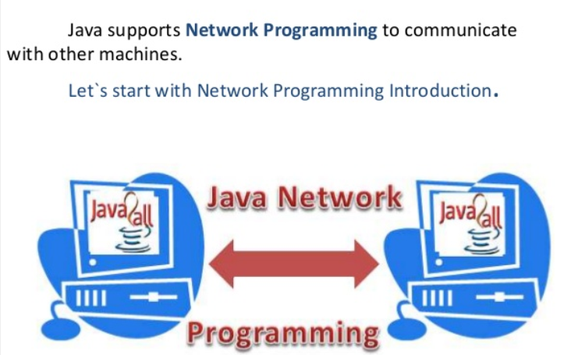

Slide 64
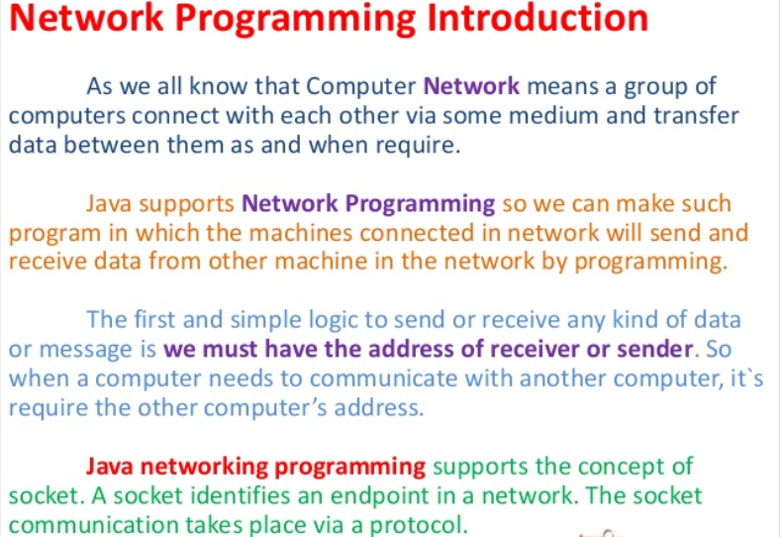

Slide 65
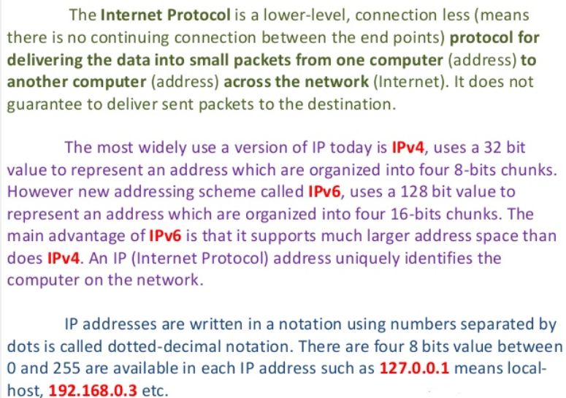

Slide 66
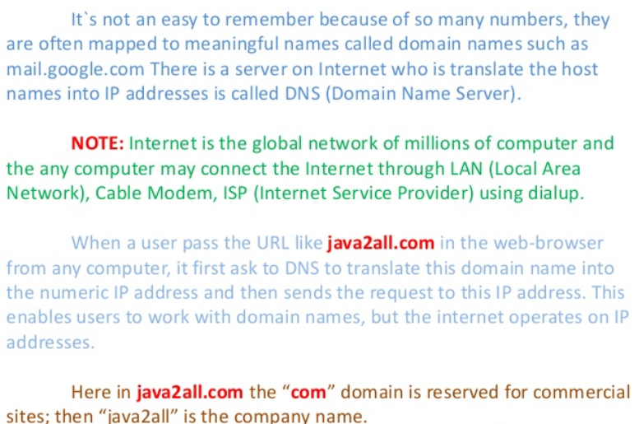

Slide 67
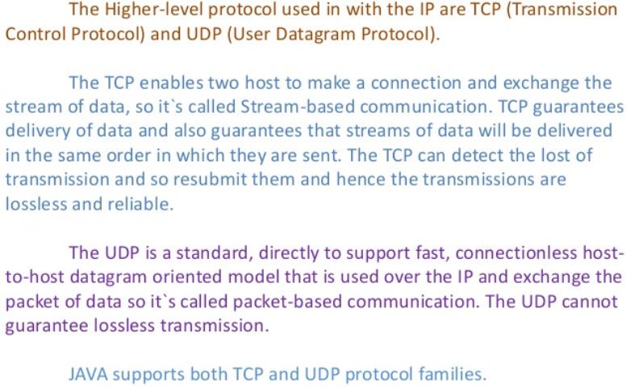

Slide 68
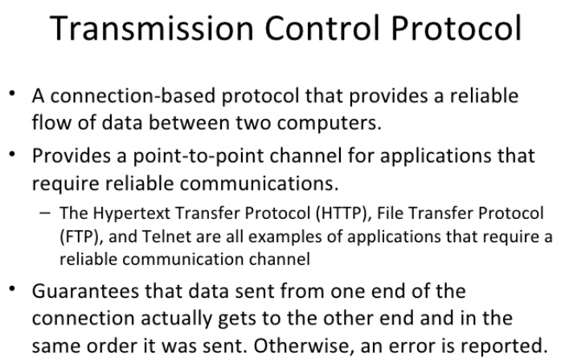

Slide 69
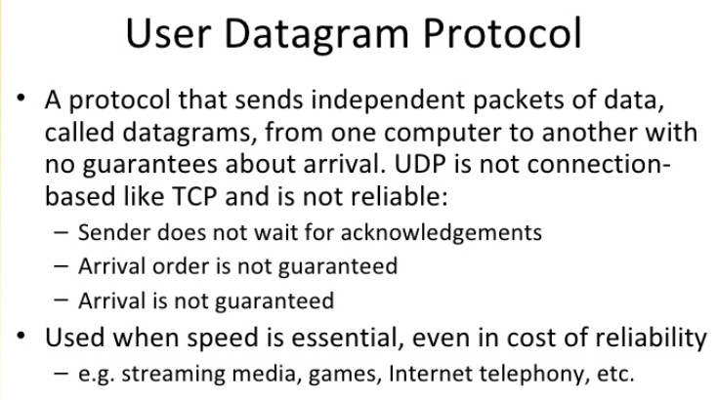

Slide 70


Slide 71
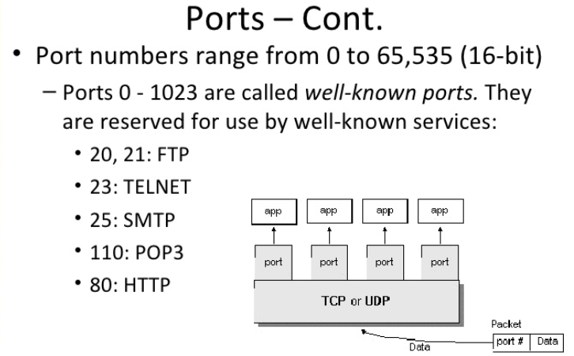

Slide 72


Slide 73
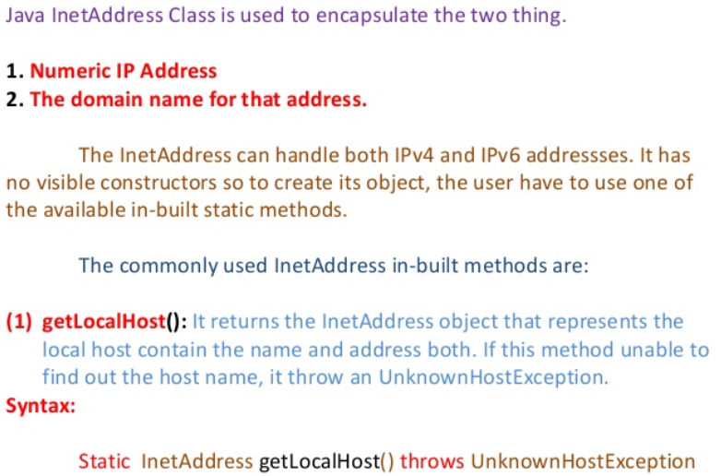

Slide 74
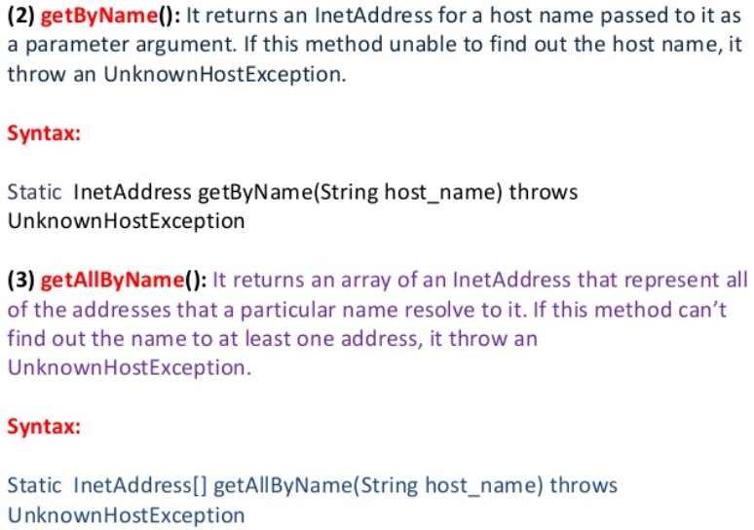

Slide 75
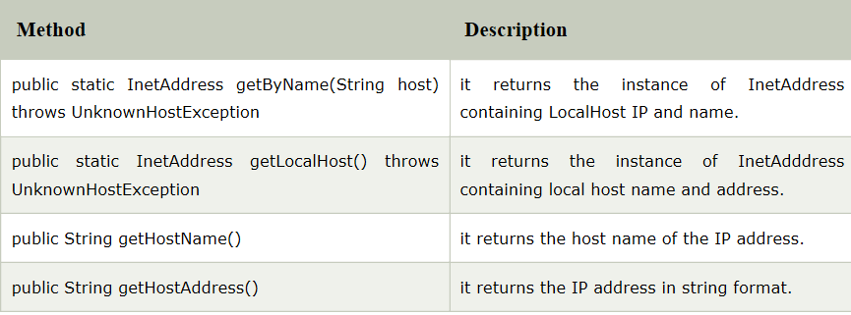
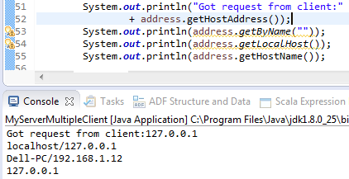
Notes:
if a company's domain name is "example.com." and a particular computer in the company has been named "plato", the hostname for that computer will be "plato.example.com.". "The localhost is the default name describing the local computer address also known as the loopback address. For example, typing: ping localhost would ping the local IP address of 127.0.0.1 (the loopback address). When setting up a web server or software on a web server, 127.0.0.1 is used to point the software to the local machine."localhost refers to "this computer" or even more accurately "the computer I'm working on." "IP" stands for Internet Protocol, so an IP address is an Internet Protocol address. IP addresses can be either static or dynamic. Static IP addresses never change. They serve as a permanent Internet address and provide a simple and reliable way for remote computers to contact you. Static IP addresses reveal such information as the continent, country, region, and city in which a computer is located. Dynamic IP addresses are temporary and are assigned each time a computer accesses the Internet. They are, in effect, borrowed from a pool of IP addresses that are shared among various computers. Since a limited number of static IP addresses are available, many ISPs reserve a portion of their assigned addresses for sharing among their subscribers in this way. Static IP addresses are generally preferable for such uses as VOIP (Voice over Internet Protocol), online gaming, or any other purpose where users need to make it easy for other computers to locate and connect to them. Easy access can also be facilitated when using a dynamic IP address through the use of a dynamic DNS service, which enables other computers to find you even though you may be using a temporary, one-time IP address. This often entails an extra charge, however, so check with your ISP.
Static IP addresses are considered somewhat less secure than dynamic IP addresses, since they are easier to track for data mining purposes. However, following safe Internet practices can help mitigate this potential problem and keep your computer secure no matter what type of IP address you use.

Slide 76


Slide 77
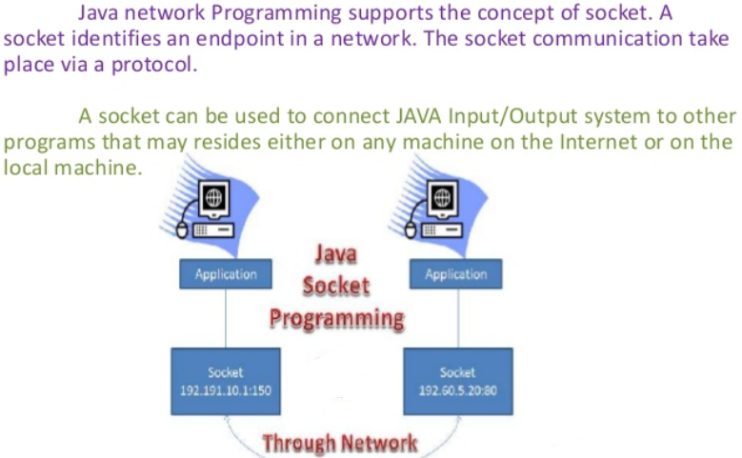

Slide 78
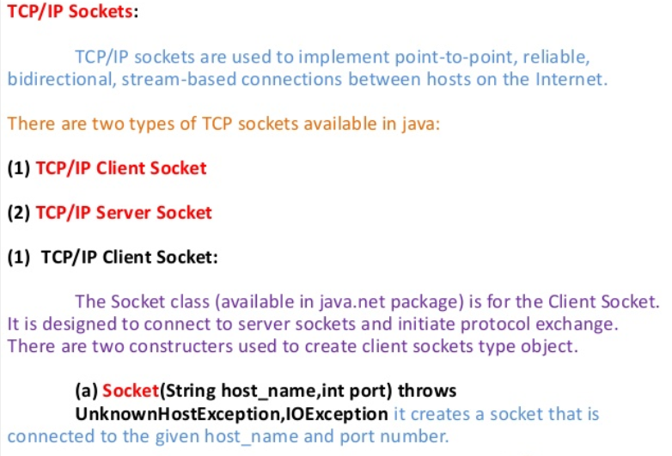

Slide 79
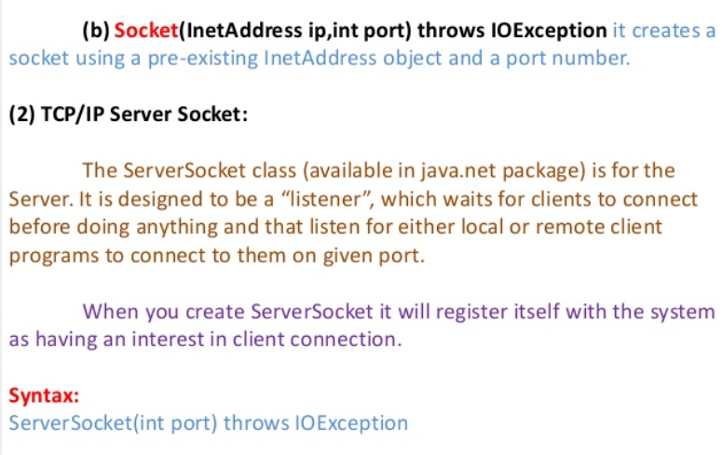

Slide 80
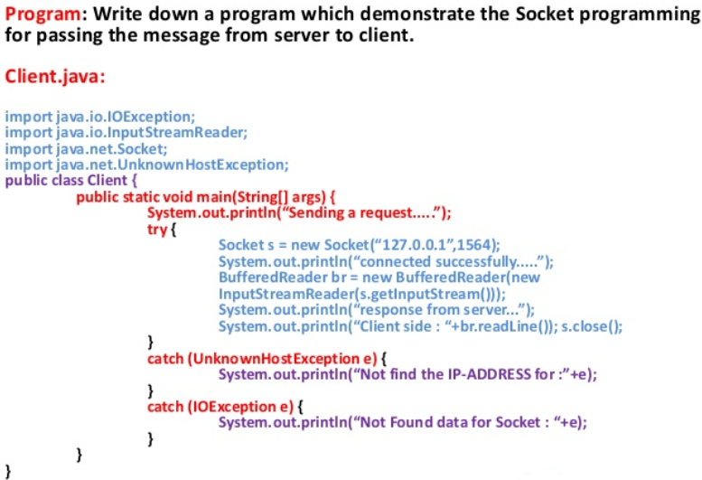

Slide 81
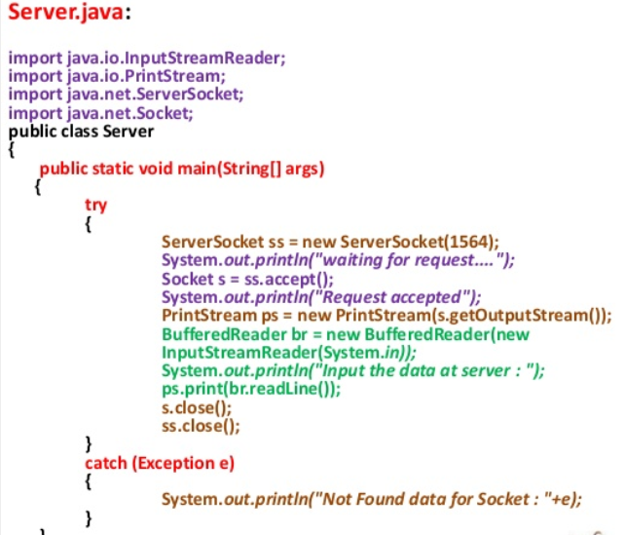

Slide 83
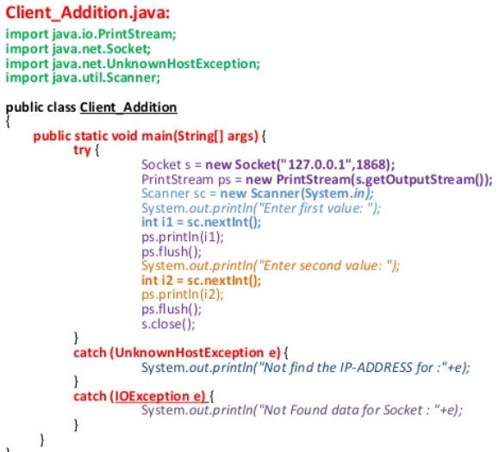

Slide 84
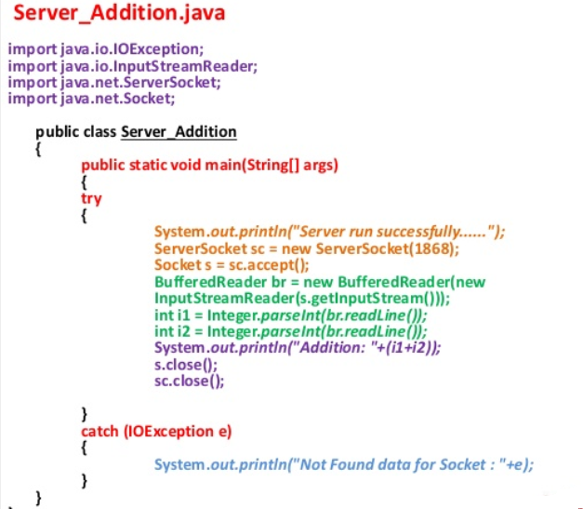

Slide 85
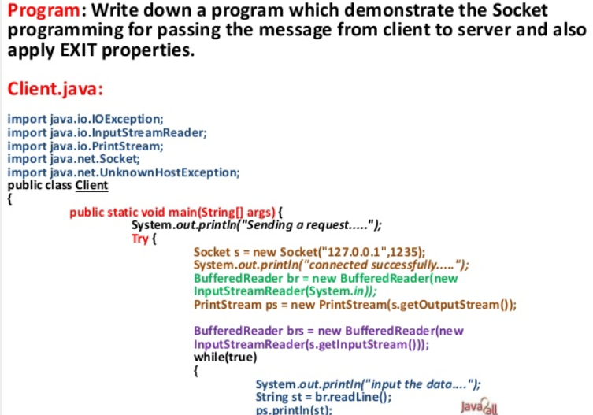

Slide 86
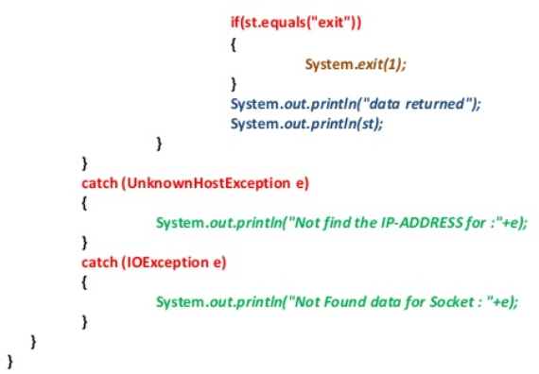

Slide 87
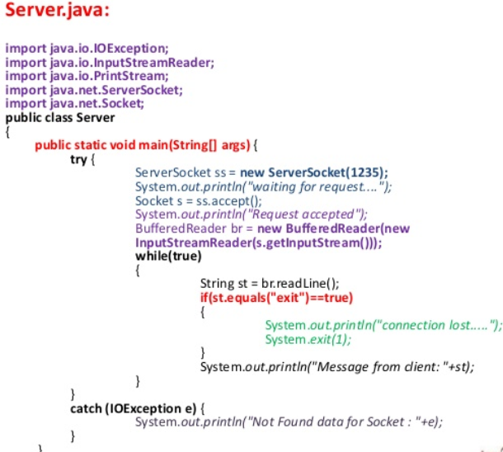

Slide 88
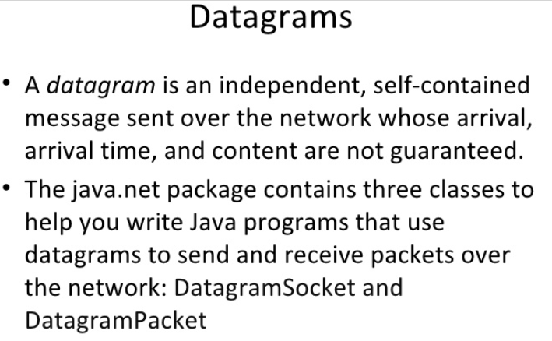

Slide 89
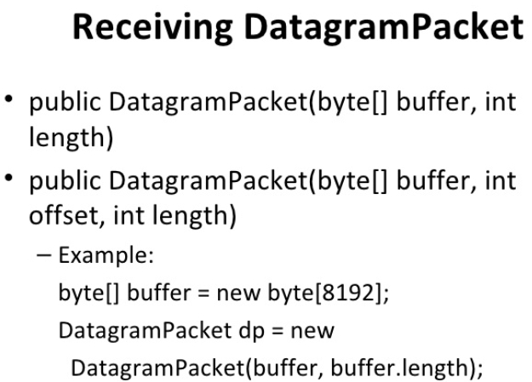

Slide 90
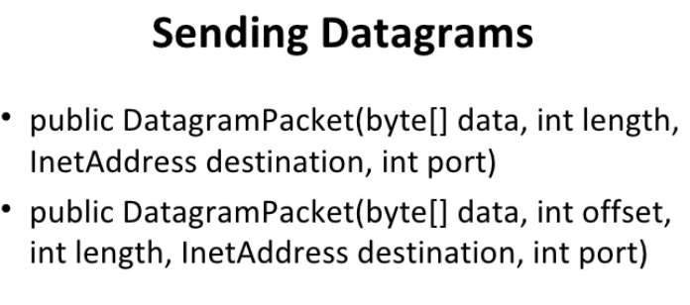

Slide 91
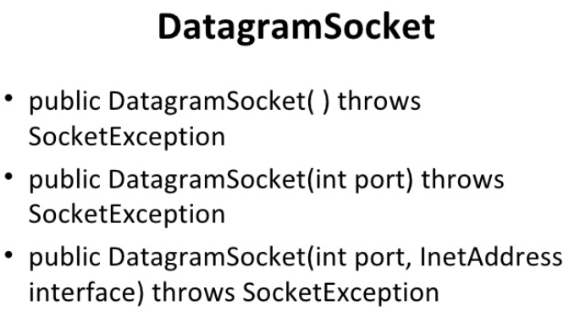

Slide 92
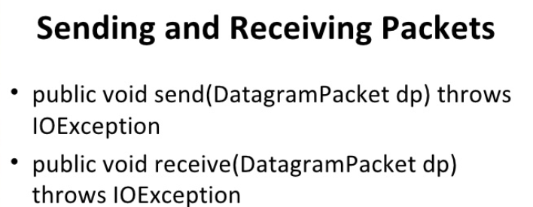

Slide 93
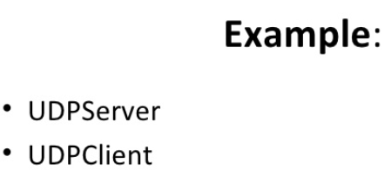

Slide 94
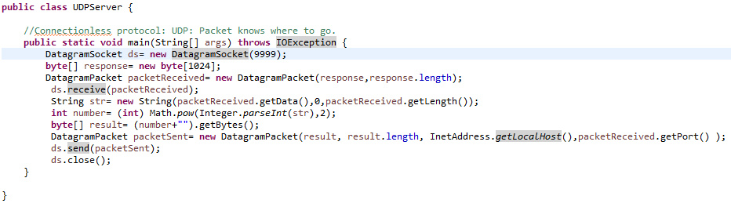

Slide 95
